Slide 1
Controlling: Cost element and Cost center accounting
Notes:
This Inhouse course was developed to meet the needs of SAP R/3 Consultants working at Capgemini. This course is designed to present a high level view of Controlling and to provide the Consultants with basic information about how to use this Functionality.
More indepth courses have been developed to train Consultants in specific areas discussed during this course.
Your comments at the conclusion of this training session are appreciated and will help us better tailor future courses to meet your training needs.

Slide 2
Cost Element Accounting
Cost Element Accounting component provides information which includes the costs and revenue for an organization. These postings are automatically updated from FI (Financial Accounting) to CO (Controlling). The cost elements are the basis for cost accounting and enable the user to display costs for each of the accounts that have been assigned to the cost element.
There are two types of Cost elements
Primary cost elements
Secondary cost elements

Slide 3
Primary cost elements
Primary Cost or Revenue Element: A primary cost or revenue element is a cost or revenue relevant item in the chart of accounts, for which a corresponding general ledger (G/L) account exists in Financial Accounting (FI). You can only create the cost or revenue element if you have first defined it as a G/L account in the chart of accounts and created it as an account in Financial Accounting. The SAP System checks whether a corresponding account exists in Financial Accounting.
Examples of primary cost elements include:
Material costs
Personnel costs
Energy costs

Slide 4
Secondary Cost Elements:
Secondary cost elements can only be created and administrated in cost accounting (CO). They portray internal value flows, such as those found in internal activity allocation, overhead calculations and
settlement transactions.
When you create a secondary cost element, the SAP System checks whether a corresponding account already exists in Financial Accounting. If one exists, you can not create the secondary cost element in cost accounting.
Examples of secondary cost elements include:
Assessment cost elements
Cost elements for Internal Activity Allocation
Cost elements for Order Settlement

Slide 5
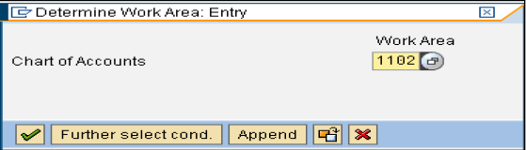
Creation of primary and secondary cost elements (Automatic Creation)
Step 1:Make Default Settings
Path: SPRO->Controlling->Cost Element Accounting->Master Data->Cost Elements->Automatic Creation of Primary and Secondary Cost Elements->Make Default Settings.
Enter your chart of account and press enter key or click on continue button.

Slide 6

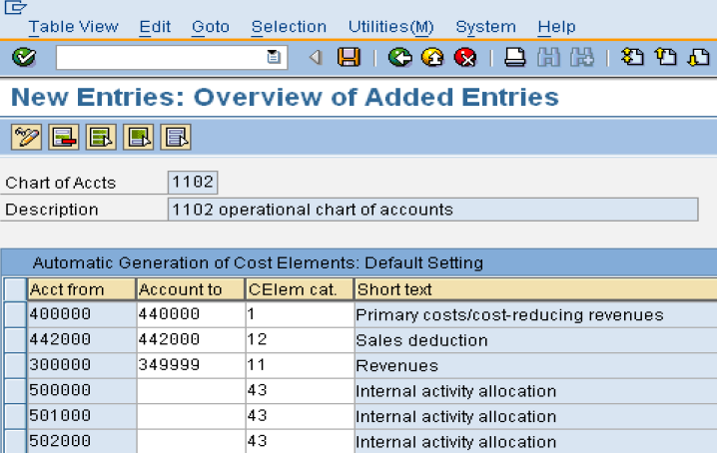
Creation of primary and secondary cost elements (Automatic Creation)
In the next screen click on button
Click on save button

Slide 7
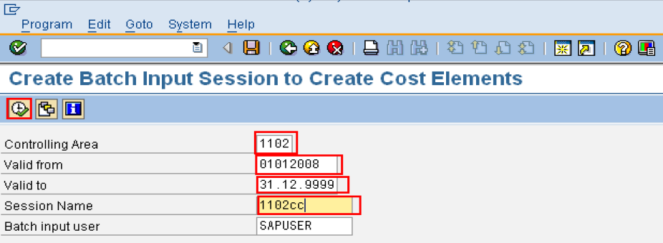
Creation of primary and secondary cost elements (Automatic Creation)
Step 2: Create Batch Input Session
Path: SPRO->Controlling->Cost Element Accounting->Master Data->Cost Elements->Automatic Creation of Primary and Secondary Cost Elements-> Create Batch Input Session.
In the below window enter all parameters and click on execute button

Slide 8
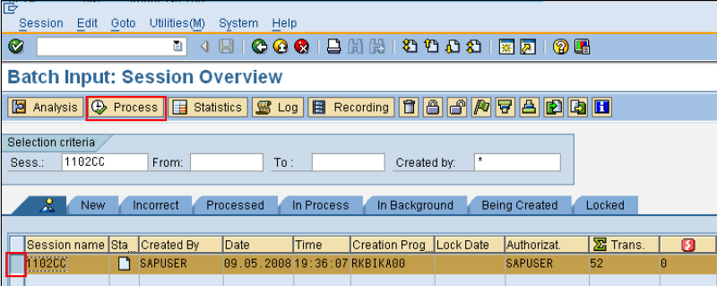
Creation of primary and secondary cost elements (Automatic Creation)
Step 3: Execute Batch Input Session
Path: SPRO->Controlling->Cost Element Accounting->Master Data->Cost Elements->Automatic Creation of Primary and Secondary Cost Elements-> Execute Batch Input Session.
Select the session and click on Process button.

Slide 9
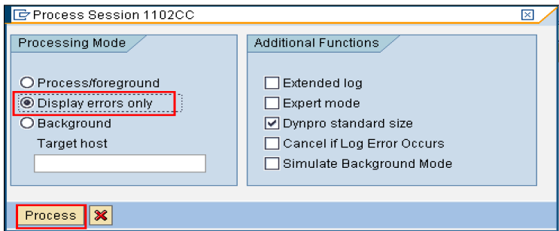
Creation of primary and secondary cost elements (Automatic Creation)
In the above window select “Display errors only” radio button and click on Process button.

Slide 10
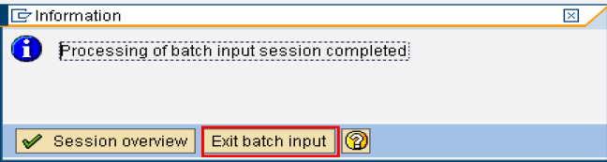
Creation of primary and secondary cost elements (Automatic Creation)
The session has been executed and below window will display here just click on “Exit Batch Input” button
By this cost elements are created automatically
NOTE: TO CREATE INDIVIDUAL PRIMARY COST ELEMENT TRANSACTION CODE IS KA01
TO CREATE INDIVIDUAL SECONDARY COST ELEMENT TRANSACTION CODE IS KA06

Slide 11
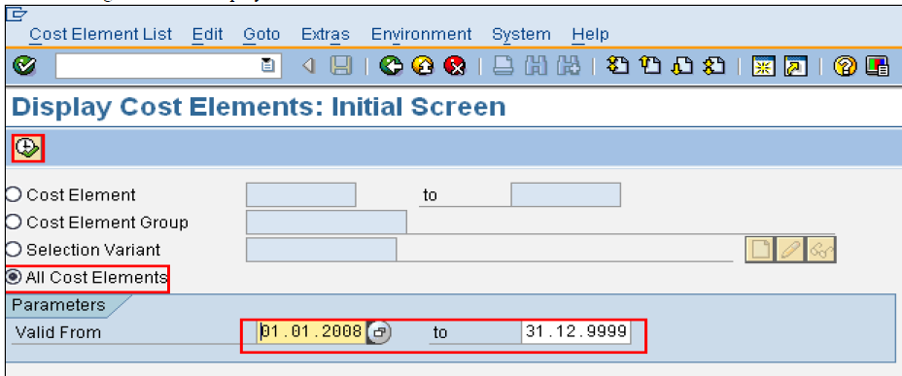
Display Cost Element Information
Path: Accounting > Controlling > Cost Element Accounting>Information System > Reports for Cost and Revenue Element Accounting (New) > Master Data Indexes > KA23 Cost Elements: Master Data Report
Transaction code: KA23

Slide 12
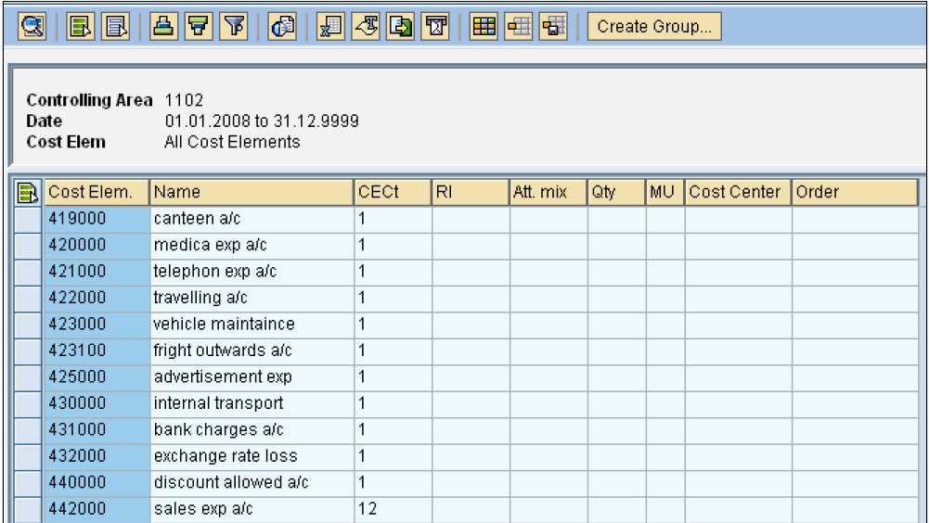
Report output

Slide 13
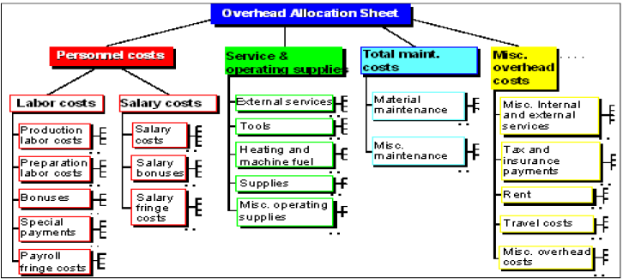
Cost Element Group
You can collect cost elements with similar characteristics in cost element groups.
The following graphic shows an example of a cost element group.

Slide 14
Cost Element Group
We can use cost element groups in the information system, for example. You can use the cost element group structure to
define the row structure of your reports. Totals are calculated in the report for each node.
we can also use cost element groups whenever you want to process several cost elements in one transaction. For example,
in cost center planning, distribution or assessment.

Slide 15

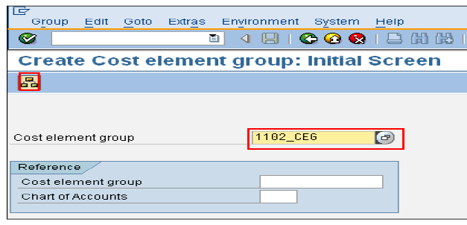
Cost Element Group Creation
Path: Accounting > Controlling > Cost Element Accounting > Master Data> Cost Element Group> KAH1-Create.
The following screen will display
Enter Cost Element Group press enter or click on Hierarchy button

Slide 16
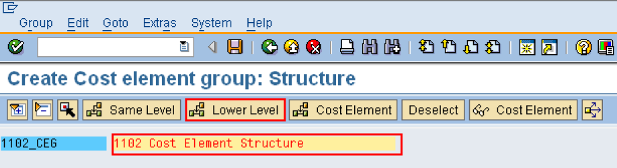
Cost Element Group Creation
It will take you to following screen
Enter the details and click on Lower level button

Slide 17
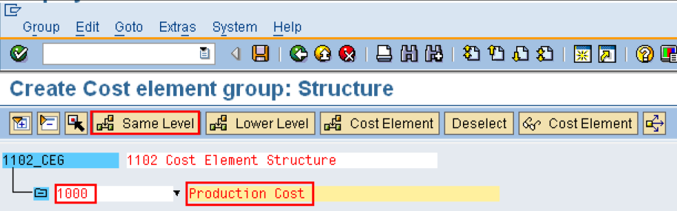
Cost Element Group Creation
it will display another level under this structure as follow:
Enter the required details.

Slide 18
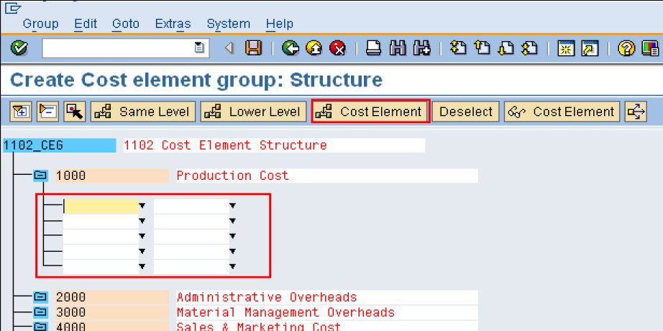
Cost Element Group Creation
To assign Cost Elements to each group place the curser on “1000” and click on “Cost Element” Button.

Slide 19
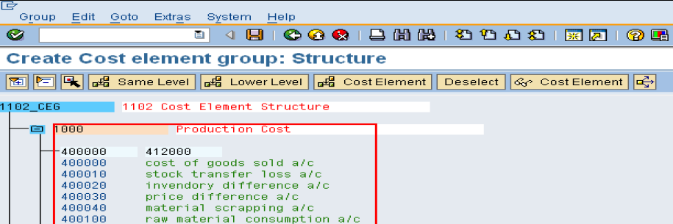
Cost Element Group Creation
Select the cost elements which needs to be assigned to the group and save.
This will complete the creation of cost element hierarchy

Slide 20
Cost Center Accounting
You use Cost Center Accounting for controlling purposes within your organization. The costs incurred by your organization should be transparent. This enables you to check the profitability of individual functional areas and provide decision-making data for management. This requires that all costs be assigned according to their source. However, source-related assignment is especially difficult for overhead costs. Cost Center Accounting lets you analyze the overhead costs according to where they were incurred with in the organization.

Slide 21
Cost Center Accounting
Depending on the level of decision-making powers assigned to the manager of an organizational unit, you can distinguish
between various types of responsibility areas within an organization:
Cost center | Recording costs with reference to plan values
Profit centers | Calculating operating results
Investment centers | Calculating Return On Investment In the SAP system you can create an investment center in the Profit Center Accounting component (EC-PCA). You do this by assigning balance sheet items to a profit center.

Slide 22
Features:
Entering actual costs: Primary costs can be transferred to Cost Accounting from other components, for example, Materials Management (MM), Asset Accounting (AA), Payroll Accounting (PY). Additional costs and outlay costs are recorded using the accrual method.
Allocating actual costs: You can use various methods to further allocate the actual costs you have recorded, according to their source. The system distinguishes between transaction-based allocations, which occur within one period, and period based allocations, which occur at period end.
Planning activities and costs: You can use planning to define organizational targets and carry out regular cost effectiveness checks. Variances can be calculated by comparing the actual costs and activities with the plan values. These variances serve as a control signal, which helps you to correct business processes, when required. You can plan costs and activities to determine allocation (activity) prices.

Slide 23
Features (Cont..)
Allocating plan costs: All actual allocations that occur for cost centers can also be planned (for example, distribution, assessment, indirect activity allocation).
Entering plan and actual statistical key figures: Statistical key figures are used as the basis for the indirect allocation methods, as well as for evaluations in the information system (for example, employees, telephones).
Activity Accounting: Activity Accounting uses the activity produced by a cost center as the tracing factor for the costs. You can use activities to measure the operating rate or the rate of capacity utilization for a cost center. The target costs of the cost center refer to the activity output. Depending on the source of the costs, the activities of a cost center are divided into various activity types (for example, for the Work center cost center: Repair hours or Assembly hours.)
Information system: The information system provides tools with which you can analyze the cost flows that have occurred in your organization. You can carry out standard recurring evaluations; and create special reports for unique tasks or situations.

Slide 24
Cost Center Categories
To classify and specify the types of cost center and to control the data flow to the cost centers by cost center
category you can maintain the following types of data to cost centers:
1. Planed Primary cost
2. Planed Secondary Cost
3. Planed Revenues
4. Actual Primary Cost
5. Actual Secondary Cost
6. Actual revenue
7. Commitment Items
8. Functional Area in Formation
9. Quantitative Information

Slide 25

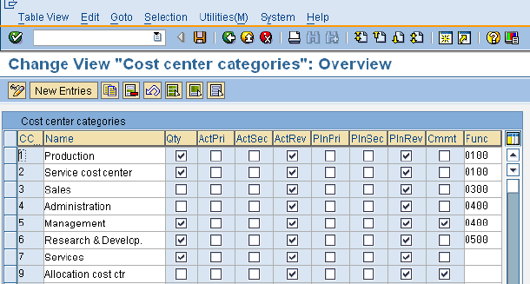
Define Cost Center Categories
Path: SPRO-> Controlling-> Cost Center Accounting-> Master Data-> Cost Centers-> Define Cost Center Categories
Transaction code: OKA2
SAP provided all types of Cost Centers Categories as we shown below. If you want to create any new click on and specify Cost Center Category (CCTC), name and all other parameters and save.

Slide 26
Cost Center Group
You can collect cost centers according to various criteria into groups. This enables you to use cost centers to depict the structure of the organization in the SAP System.
You can use the groups to build cost center hierarchies, which summarize the decision-making, responsibility, and control areas according to the particular requirements of the organization. The individual cost centers form the lowest hierarchical level.
There must be at least one group that contains all cost centers and represents the entire business organization. This cost center group is described as the standard hierarchy. You can assign more cost center groups to the standard hierarchy.

Slide 27
Cost Center Group (Cont.…)
You can also create any number of alternative groups. You can structure these, for example, according to organizational and/or functional viewpoints. Cost center groups enable you to perform evaluations for each decision-making, responsibility, or control area. They also support the processes during planning and internal allocations.
You can assign each cost center to only one group in the standard hierarchy, but to as many alternative groups as you require.

Slide 28

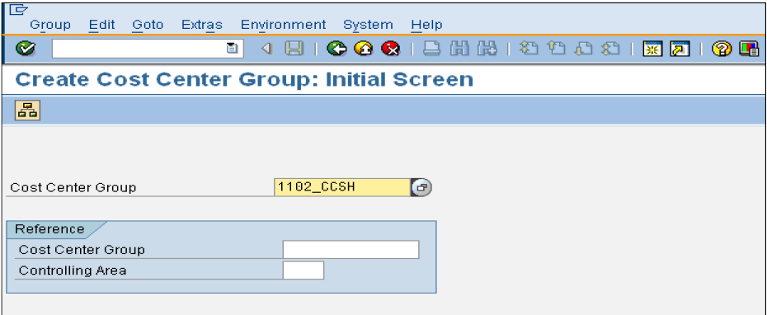
Creation of Cost Center Group
Path: Accounting-> Controlling-> Cost Center Accounting-> Master Data-> Cost Center Group-> KSH1 – Create
Transaction Code: KSH1
In above screen Cost Center Group name will display automatically and just click on Hierarchy button

Slide 29
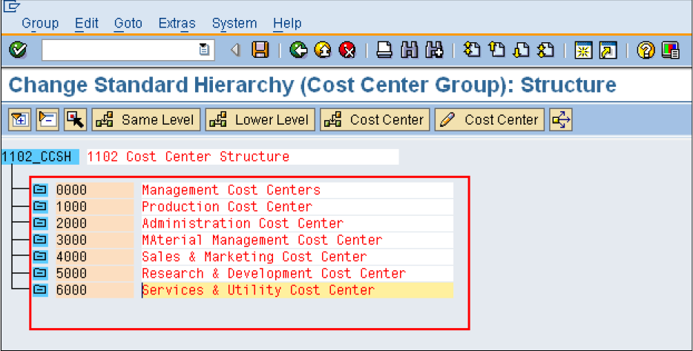
Creation of Cost Center Group
In the below screen type the description and place the curser on the same window and click on Lower Level button
so it will display Lower Level Group. Enter the details of the groups that needs to be created.
In case if you want to create a group in the same level. Click same level button.

Slide 30
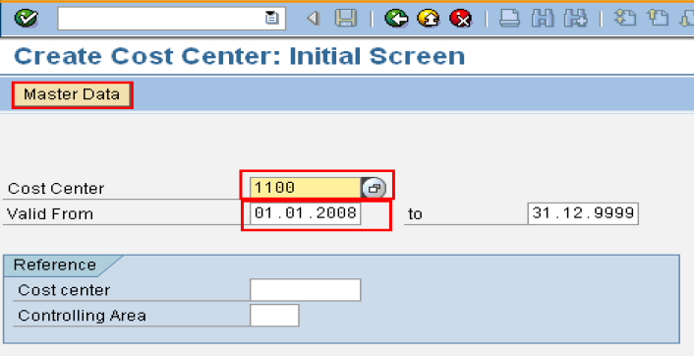
Creation of Cost Centers
Path: Accounting-> Controlling-> Cost Center Accounting-> Master Data-> Cost Center-> Individual Processing ->KS01 – Create
Transaction Code: KS01
In the below window enter the details:
1) Cost Center number
2) Valid From
3) To

Slide 31
Creation of Cost Centers
Enter above parameters and click on save button to save the activity.
Immediately after you click on save button it will save and take you to previous screen. So you can change the Cost Center number and create another one.

Slide 32
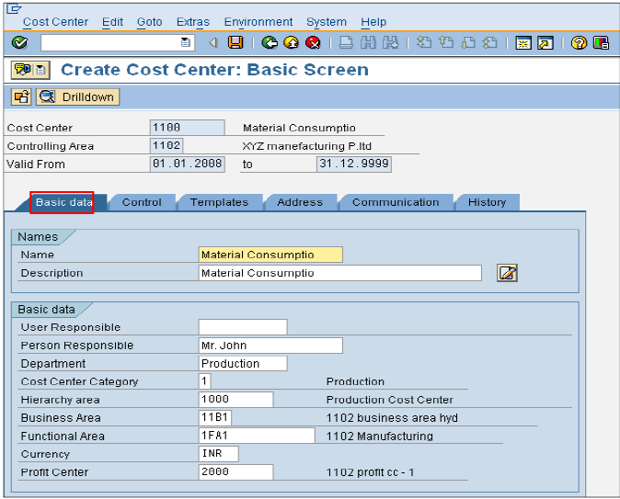
Creation of Cost Centers

Slide 33
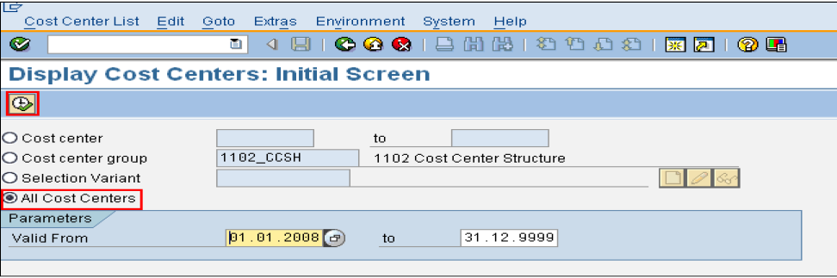
To print Cost Center Information
Path: Accounting-> Controlling-> Cost Center Accounting-> Information System -> Reports for Cost Center Accounting -> Master Data Indexes-> KS13 - Cost Centers: Master Data Report
Select “All Cost Centers” and click on button

